Slide 1
Skill Forge AI Driven Adaptive Learning and Exam Generator
M.SHIVANI
CSE(DATA SCIENCE)

Slide 2
WHAT IS SKILLFORGE EXAM GENERATOR ?
SkillForge is an AI-driven adaptive learning and exam generation platform designed to improve student learning outcomes.
It analyzes student performance to identify strengths and weak areas.
The system recommends personalized study material and practice problems based on the learner’s level.
It automatically generates quizzes and exams with appropriate difficulty levels.
Helps students learn at their own pace and track progress effectively.
Reduces manual effort for instructors by automating assessment and performance monitoring.
Overall, the system aims to make learning more personalized, efficient, and effective.

Slide 3
Problem Statement
Traditional learning systems provide the same study material and exams to all students, ignoring individual learning speed and skill level.
This approach results in ineffective learning, where some students struggle while others are not challenged enough.
Manual exam preparation requires significant time and effort from instructors.
Existing systems often lack continuous performance analysis and personalized feedback.
Students find it difficult to identify weak areas and track progress effectively.
Therefore, there is a need for a system that analyzes performance, provides personalized learning, adapts difficulty levels, and automatically generates assessments.

Slide 4
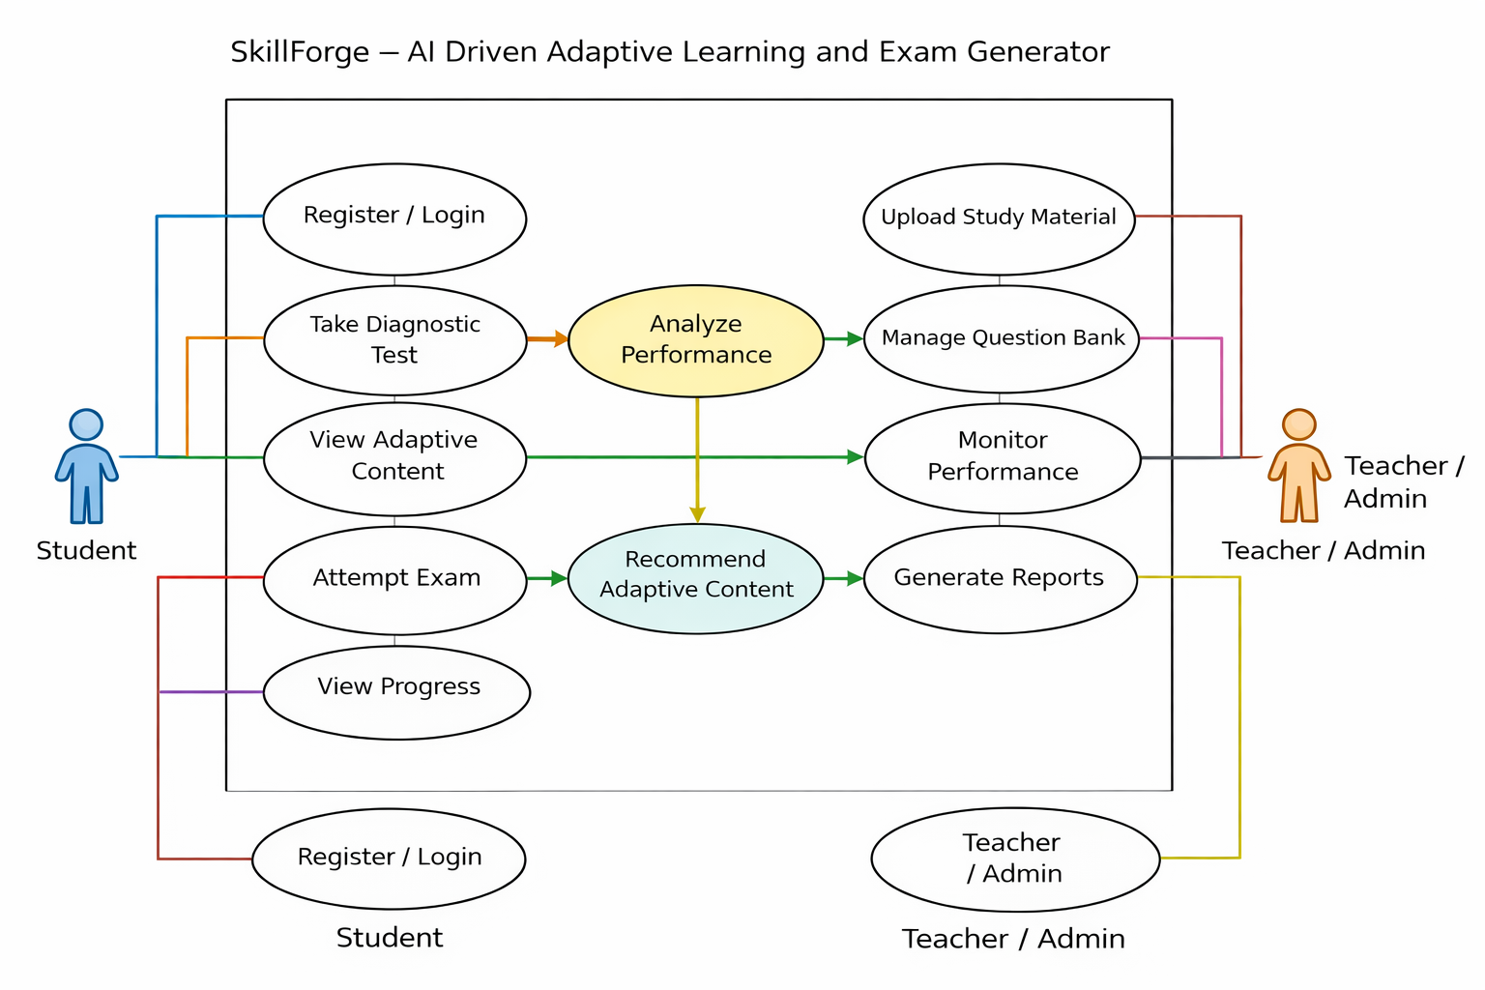
USE CASE DIAGRAM

Slide 5
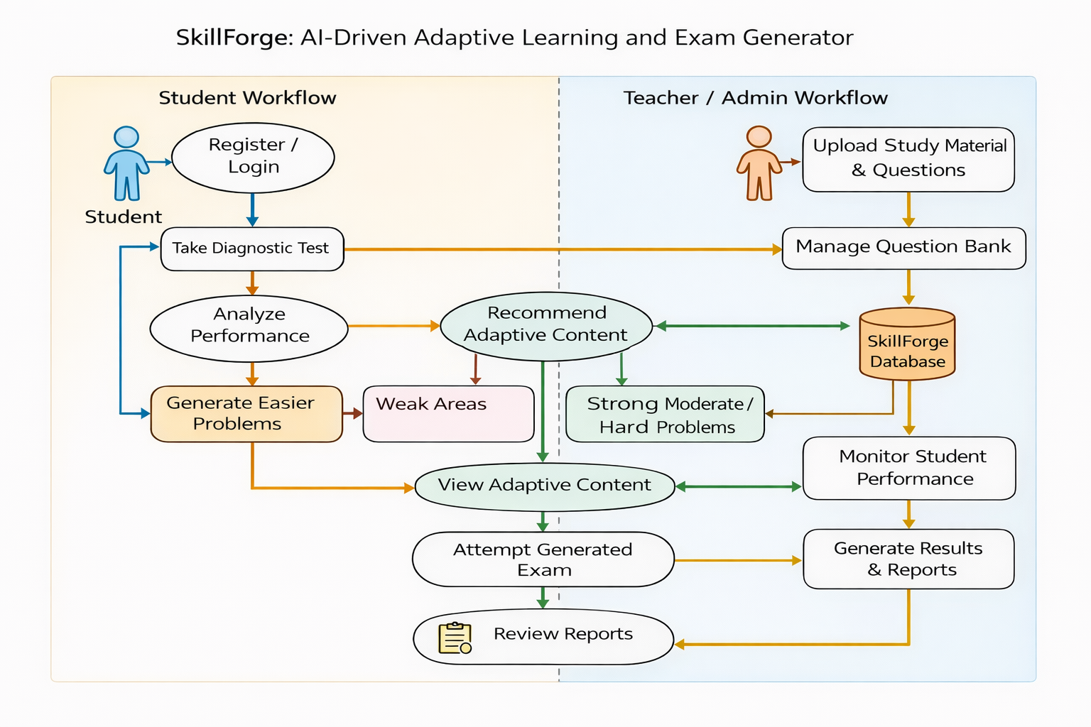
WORKFLOW DIAGRAM

Slide 6
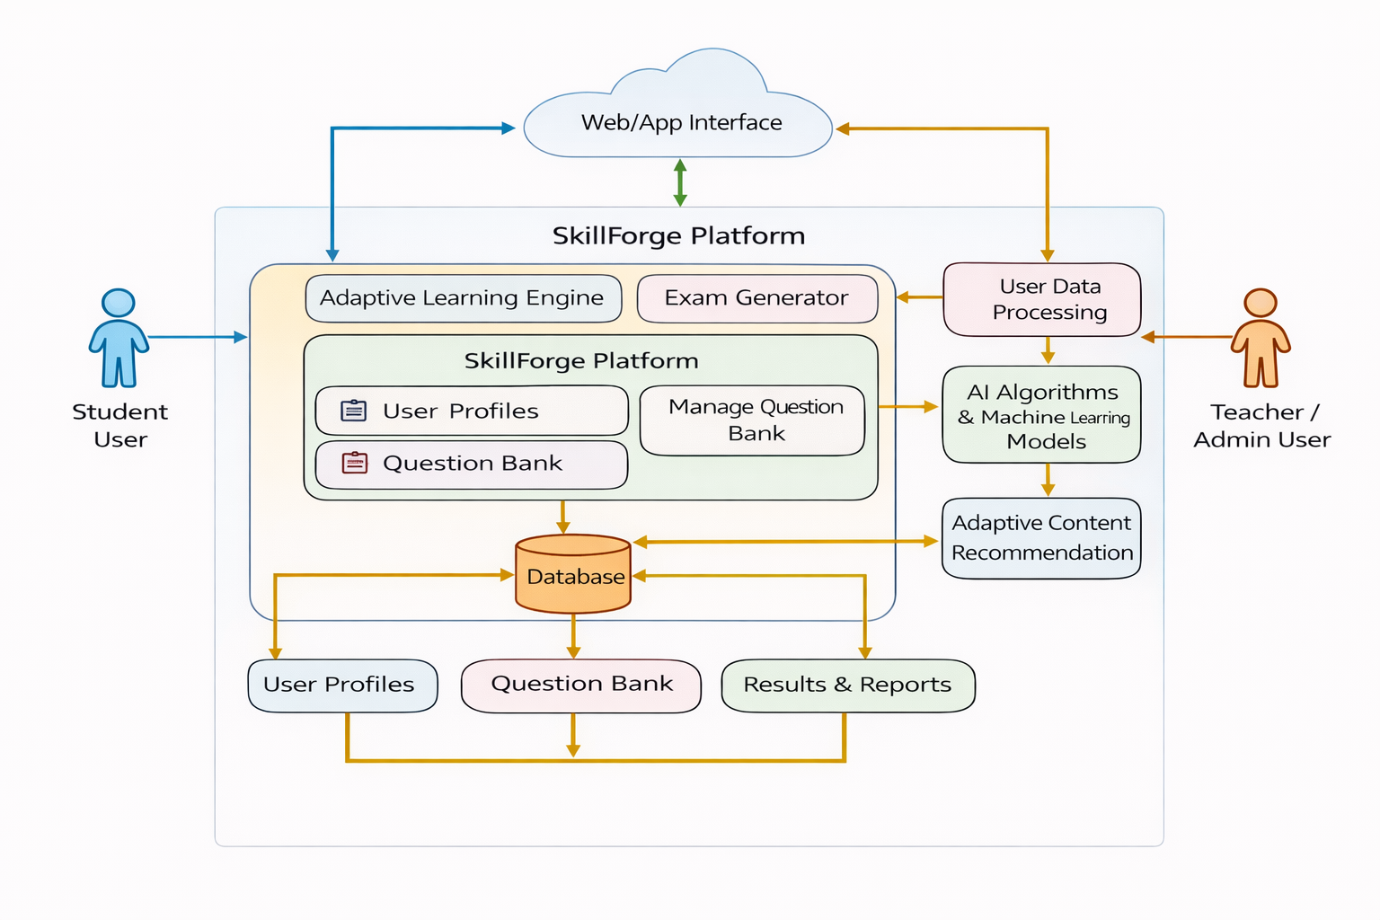
SYSTEM ARCHITECTURE

Slide 7
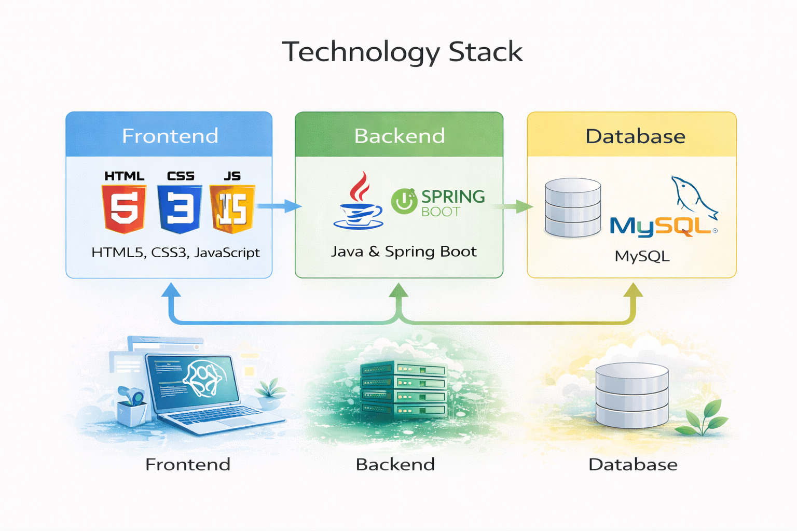
TECHNOLGY STACK

Slide 8


